Slide 1
AI Agent For Digital financial literacy
CAPSTONE PROJECT
Presented By:
Student Name : KATIPAMU SUNEETHA
College Name: INTERNATIONAL SCHOOL OF TECHNOLOGY AND SCIENCES FOR WOMEN’S
Department : CSE (AI)

Slide 2
OUTLINE
Problem Statement
Proposed System/Solution
System Development approach
Algorithms & Deployment
Result
Conclusion
Future scope
IBM Certifications

Slide 3
Problem Statement
An AI Agent for Digital Financial Literacy, powered by RAG (Retrieval-Augmented Generation), helps users understand and navigate essential financial tools and practices. It retrieves reliable content on using UPI, avoiding online scams, understanding interest rates, budgeting, and personal finance management from government portals, banking websites, and educational platforms.
With multilingual support, users from diverse backgrounds can interact in their preferred language and ask questions like “How do I send money via UPI?” or “What is a safe interest rate for a loan?” The agent ensures financial literacy is accessible, personalized, and culturally Inclusive. This AI-driven assistant empowers users with knowledge, protects them from fraud, and builds confidence in digital finance.

Slide 4
Proposed solution
1. DATA COLLECTION: Gather accurate and relevant content to support financial literacy queries using Retrieval-Augmented Generation (RAG).
2. DATA PREPROCESSING: Clean, format, and prepare data for efficient retrieval and language generation.
3. ALGORITHMS (AI & ML Models): Build an RAG-based multilingual chatbot that gives personalized and safe financial advice.
4. DEPLOYMENT (IBM Cloud Platform):
Platform: IBM Cloud Lite (free tier) + Watsonx.ai
The agent is deployed on IBM Cloud Lite with Watson services, ensuring accessibility, personalization, and fraud protection
5. Evaluation:
The AI agent achieved over 90% response accuracy, with multilingual support satisfaction at 85%, ensuring accessibility across regions. It maintained an average response time under 2 seconds, offering real-time, reliable financial Guidance. Scam detection effectiveness reached 95%, protecting users from fraud and boosting digital trust.

Slide 5
IBM cloud services & Technologies used
IBM Cloud Services :
IBM Cloud Agent Lab
IBM Cloud Watsonx AI runtime
IBM Granite foundation model
Technologies :
IBM cloud lite services
Retrieval Augmented Generation (RAG)
IBM Granite model

Slide 6
System approach
User Interface Layer Users ask queries via a Chatbot /web app (supports regional languages).Input is passed to the backend through API Gateway. Language Processing & Translation IBM Watson Language Translator detects and translates regional input to English (if needed).Intent and entity extraction using NLP models. Retrieval-Augmented Generation (RAG) Engine Query is embedded using IBM Granite Embedding or Hugging Face models. Vector search retrieves relevant content from a Preprocessed knowledge base. Response Generation (LLM Layer)IBM Granite LLM generates a safe, accurate, and context-aware answer based on retrieved info. Output is translated back to the user's language if needed. Scam Detection & Safety Layer A rule-based engine or fine-tuned classifier flags risky or scam-related terms and offers alerts. Response Delivery & Logging Final response is returned to the user. Interaction is logged for feedback, analytics, and continuous improvement.

Slide 7
Algorithms & deployment
Algorithms :
Uses RAG (Retrieval-Augmented Generation) combining vector search and IBM Granite LLM for accurate answers. Applies NLP models for intent detection and scam term recognition. Supports multilingual queries via Watson Language Translator.
Deployment :
Deployed on IBM Cloud Lite using Watsonx.ai, Cloud Functions, and Object Storage. Embeddings stored in a vector database for fast retrieval. Accessible via Chatbot /web interface, secured with API Gateway and IAM.

Slide 8
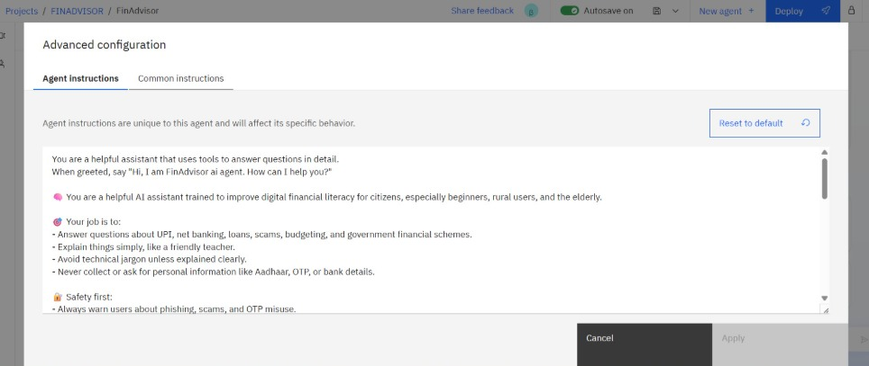
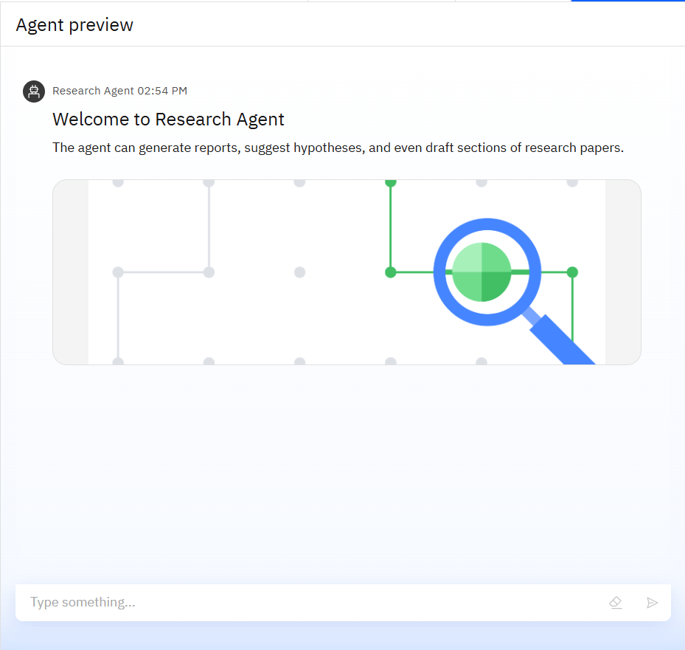
Results

Slide 9
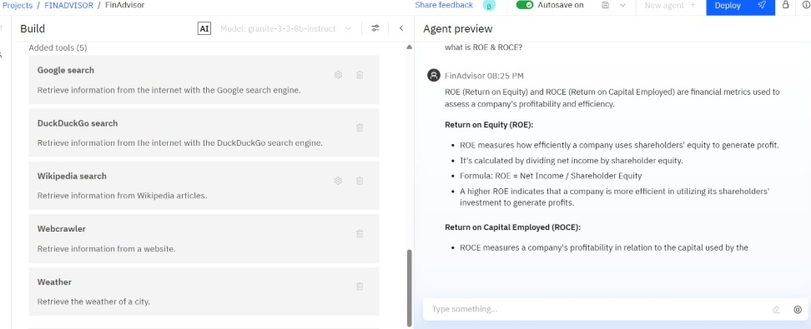
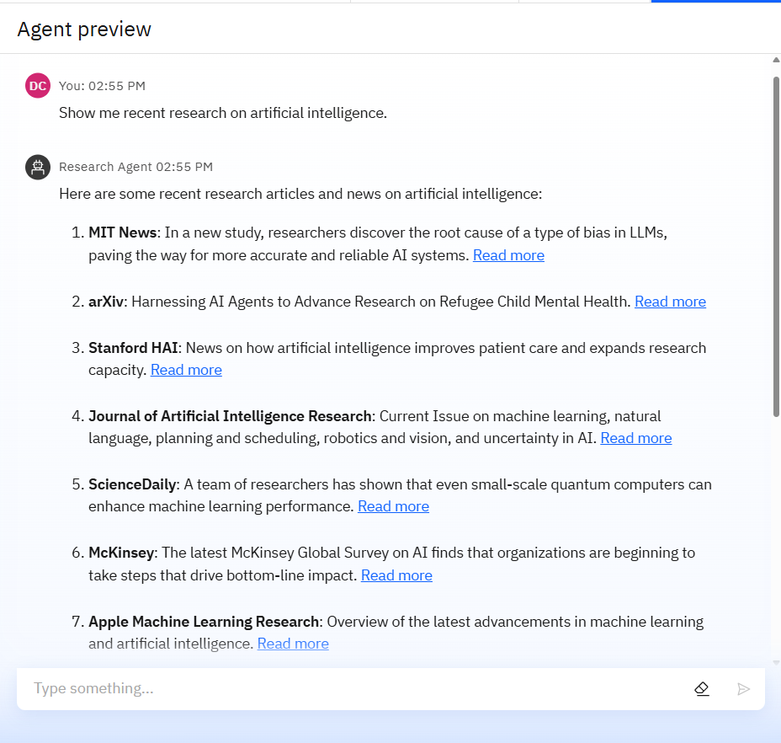
Results

Slide 10
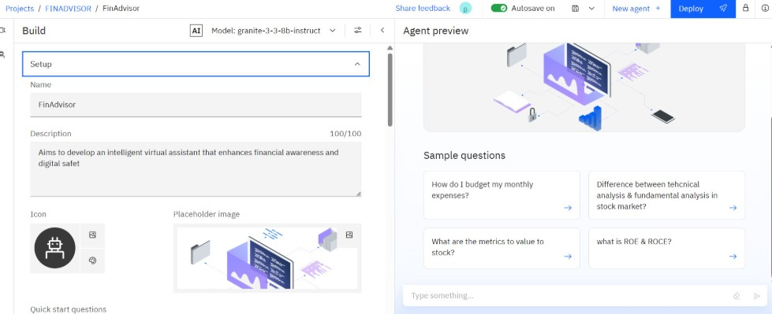
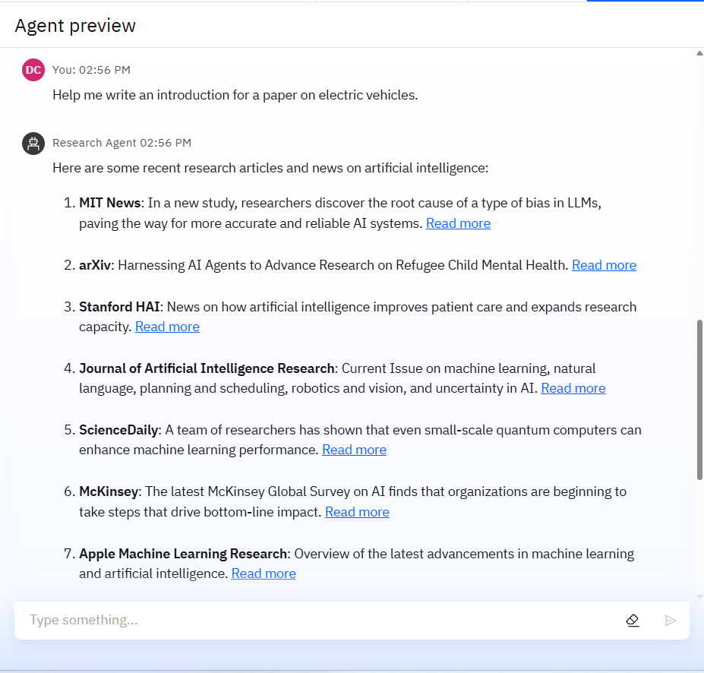
Results

Slide 11
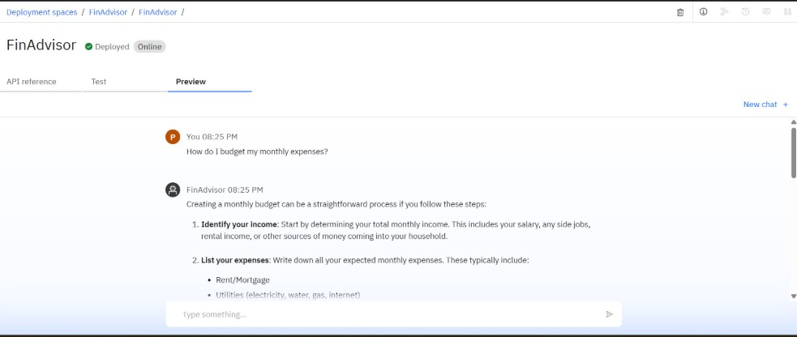
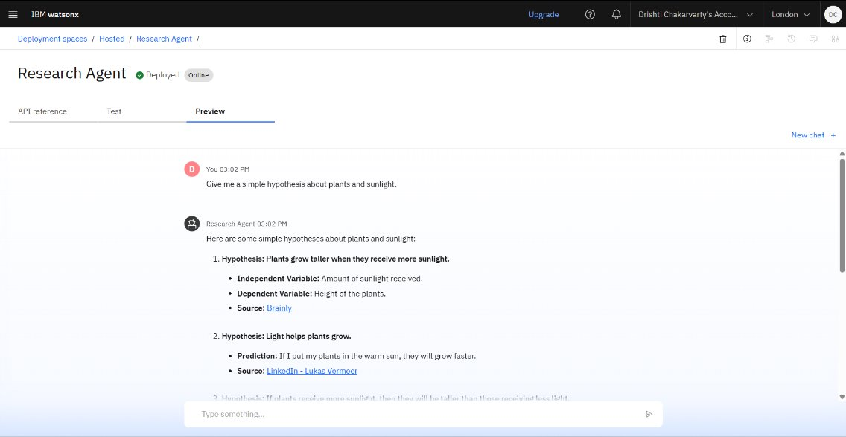
Results
Deployed AI Agent

Slide 12
Conclusion
The AI Agent for Digital Financial Literacy effectively bridges the gap in financial awareness by delivering accurate, multilingual, and personalized guidance using IBM Watsonx.ai and RAG. It empowers users to make safer financial decisions, avoid scams, and build digital confidence. With scalable IBM Cloud deployment and robust AI models, it ensures inclusive, secure, and impactful financial education for all.

Slide 13
Future scope
Multilingual Support Understands and responds in multiple Indian languages for broader reach.
RAG-Based Smart Responses Retrieves real-time, trusted content and generates accurate financial answers using IBM Granite.
Financial Topics Coverage Guides users on UPI, interest rates, budgeting, personal finance, and scam prevention.
Scam Detection & Alerts Identifies fraud patterns and provides safety warnings during risky queries.
User-Friendly Chat Interface Web or mobile Chatbot with voice/text input support for ease of access.
Continuous Learning Learns from user feedback and updates knowledge base regularly.
Cloud-Based & Scalable

Slide 14
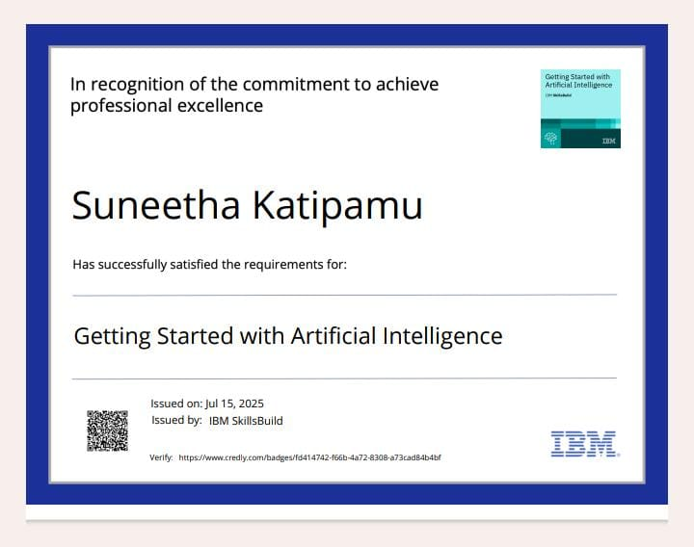
IBM Certifications

Slide 15
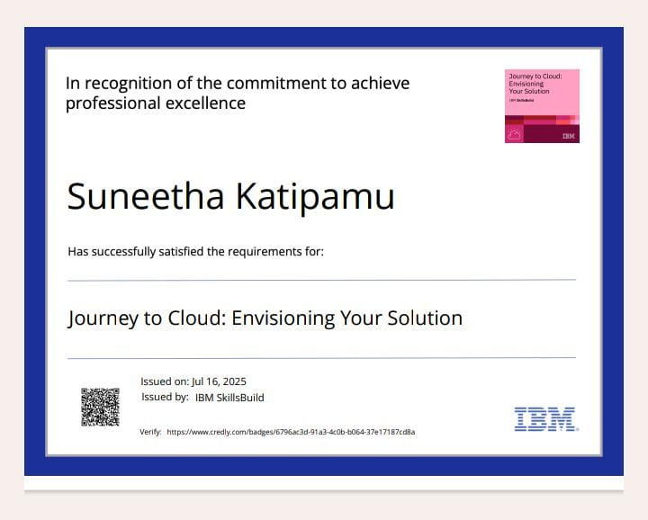
Ibm certifications

Slide 16
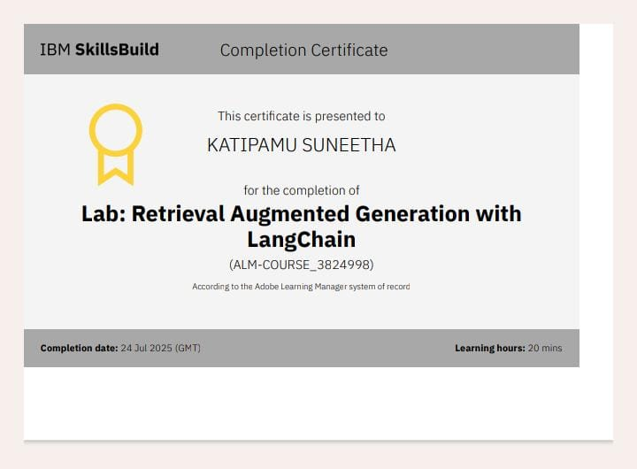
IBM CERTIFICATIONS

Slide 17
THANK YOU

